Slide 1
Module-2
Process Management
1

Slide 2
Module 2
Process Management
Process Concept, Operations on Processes, Inter Process Communication, Communication in client-server systems (sockets, RPC, Pipes), Introduction to threads - Multithreading Models, Thread Libraries, Threading Issues, Process Scheduling– Basic concepts, Scheduling Criteria, Scheduling Algorithms: FCFS, SJF, SRTF, RR and Priority.

Slide 3
Contents :
Process Concepts
Operations on Processes
Inter Process Communication- IPC
Communication in client-server systems (sockets, RPC, Pipes)
Introduction to threads
Multithreading Models
Thread Libraries
Threading Issues
Basic Concepts of Process(CPU) Scheduling
Scheduling Criterions
.
11. Scheduling Algorithms:
  FCFS
  SJF
  SRTF
  RR
  Priority
  Multilevel Queue
  Multilevel Feedback Queue
3

Slide 4
Lecture 11
Process Concept
LO1: Compare between program and process
LO2: Explain process states, PCB and context switching

Slide 5
1. Process Concepts
In the early computer systems, only one program is executing at a time. So, that one program had complete control over the system & its resources.
But, today’s computer systems allow multiple programs to execute at a time (parallely).
So, some sort of mechanism is needed to create, execute & manage those programs which are running parallely.
This is done by process manager (part of OS)
“A running program is called as process” OR
“A program in execution is called as process”
5

Slide 6
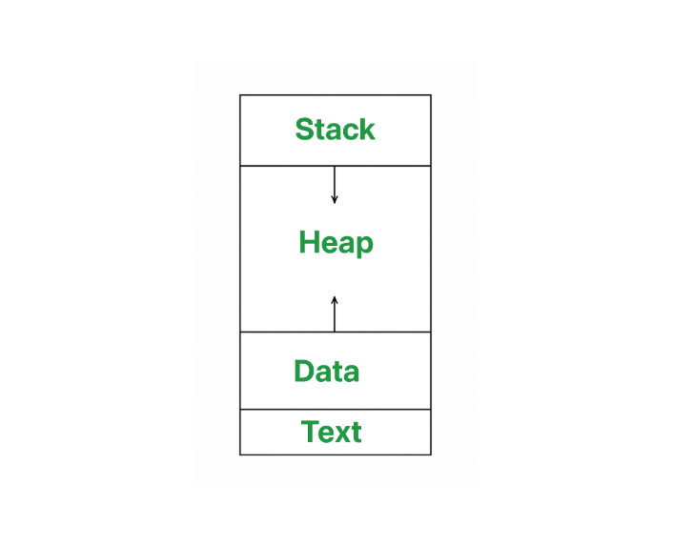
Process Concepts
An operating system executes a variety of programs:
  In Batch systems, we use the term jobs & In Time-shared systems, we use the term tasks
  In many respects, all these activities are similar & hence we call them as “processes”
  Text section includes compiled program code which is read from secondary storage when program is
  launched, Text section also includes information like
  a) which part of the program is currently executing
                b) which is next statement to be executed(i.e., content of PC)
                c) contents of other processor’s registers
                Data Section contains global variables & static variables which are allocated & initialized before executing the program
                Heap is used for dynamic memory allocation & is managed via calls to new, delete, malloc, free, etc.
                Each & every process has its own stack called process stack consists of temporary data such as function parameters, return address/values & local variables.
6

Slide 7
Process Concepts----Program vs Process:
PROCESS
Program in execution
Active entity
Program become process only when an executable file is loaded into main memory
Process holds resources such as CPU, memory address, disk, I/O, etc
It has limited life span. It is created when execution starts & terminated as execution is finished
PROGRAM
Set of instructions to perform a specific task
Passive entity
Program is stored generally in the form of file (executable)
Program doesn’t require any resources other than storage space
Program has longer life span. It is stored on disc forever

Slide 8
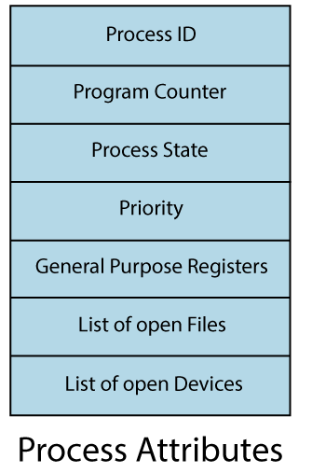
Attributes /Characteristics of a Process:
Process Id
2) Process State
3) CPU registers
4) I/O status information
5) CPU scheduling information

Slide 9
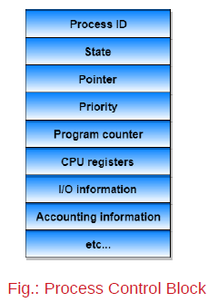
Process Control Block (PCB)
Each process is represented in OS by PCB also called as Task control block (TCB)
Every process has its own program control block(PCB), i.e.; each process will have a unique PCB
A PCB has the following information about a process:
Process number: unique id of a process
Process state – state may be ready, new, running, waiting or terminated
Program counter - location of the next instruction to be executed
CPU registers – number of registers & type of registers vary from system to system, depending upon the computer architecture. These includes accumulators, index registers, stack pointers, etc
CPU scheduling information- includes process priorities, pointers to scheduling queues & some other scheduling parameters
Memory-management information - includes where in memory the program is stored, the base and limit register values, the page table / segment table etc
Accounting information - CPU used, clock time elapsed since start, time limits
I/O status information – I/O devices allocated to process, list of open files

Slide 10
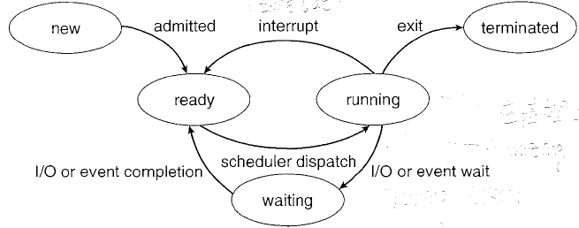
Process State Diagram:
State of a process is defined as the current activity/status of the process.
When a process starts executing, it keeps on changing its state from one state to another.

Slide 11
Process States:
The various states of a process are:
New: when process in secondary memory and need to be executed, it will be in new state.
Ready: process is allocated with few resources & set to execute, but CPU time is not allocated. That means, process is ready to execute or process is waiting for CPU allocation
Running: when the instructions of the process is getting executed, process will be in running state
Waiting(or Block): sometimes, a process has to wait for some resources to become available or for some event to occur. In such conditions, we can say process is in waiting state.
Terminated: The process completed its execution successfully.
Name of these 5 states may vary from one OS to another, but the concept remains same
It is important to realize that, only one process can be in running state at any time, but, many processes may be in ready & waiting state.

Slide 12
Context Switch
Context switch occurs when the time slice for one process has expired or an interrupt has occurred, & a new process is to be loaded from the ready queue.
Switching the CPU to another process requires state-save of the current process & a state-restore of different process. This task is known as context switch
Saving & restoring states involves saving & restoring of all of the registers & PC’s as well as the PCB
Context switching happens very frequently & the overhead of doing the switching is just loss of CPU time, so context switches(state-save & state restore) need to be as fast as possible
Special hardware is to speed up the context switching, such as single machine instructions for saving or restoring all registers at once.
When does a context switch happen?
1. When a high-priority process comes to ready state (i.e. With a higher priority than the running process)
2. An Interrupt occurs
3. User and kernel mode switch
4. Pre-emptive CPU scheduling used.
Context switching allows multiple processes to share a single central processing unit(CPU).

Slide 13
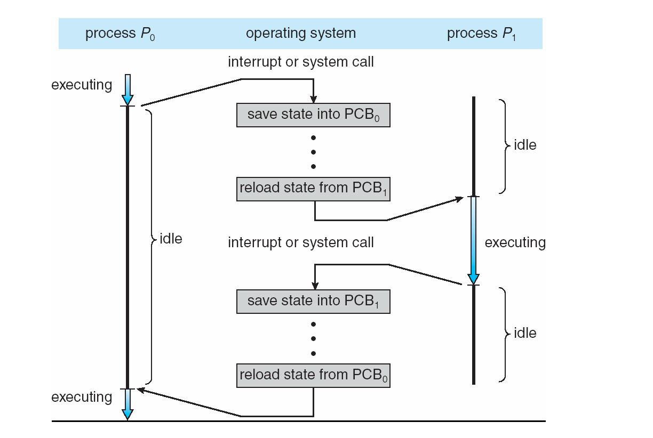
What happens when the CPU Switch From a process to another process?

Slide 14
Quiz
The processes that are residing in main memory and are ready and waiting to execute are kept on a queue called
a) job queue
b) ready queue
c) waiting queue
d) process queue
The processes that are waiting to resolve the interrupt are kept on a queue called
a) job queue
b) ready queue
c) waiting queue
d) process queue

Slide 15
Quiz
Scheduler is a program that _____ the program to be executed.
_________ is a program that does the context switching process.
The switching of the CPU from one process or thread to another is called :
a) process switch
b) task switch
c) context switch
d) all of the mentioned
Scheduling is done so as to :
a) increase the throughput
b) decrease the throughput
c) increase the duration of a specific amount of work
d) None of the mentioned

Slide 16
Lecture 12
Operations on Processes
LO1: Explain process operation
LO2: Describe IPC

Slide 17
Operations on Processes
Process can be created, executed & deleted dynamically.
A system must provide mechanisms for: process creation & process termination
Process creation
  A process may in turn can create other processes through appropriate system calls like fork or spawn or CreateProcess
  Process which creates another process is called “parent process” & newly created process is called as “child process”
  Each of these newly created processes may in turn create other processes, forming a tree of processes
  Each & every process is having an unique integer number called PID.
  Most OS’s identify the processes through PID only
  Every process needs certain resources such as CPU time, memory, files, I/O devices in order to complete its task

Slide 18
Operations on Processes----Process creation contd
  When a process creates sub-process, that sub-process may be able to obtain its resources directly from the OS or from its parent process
  So, parent process must partition its resources among its children or it should share the resources among its child's.
  When a parent process creates child process, it may pass some initialization data (i.e., input) to the child process.
  When a parent process creates a new process, 2 possibilities exist in terms execution
    *) parent process continues to execute concurrently with its children
    *) parent process waits until some or all of its children have terminated
    There are 2 possibilities in terms of address space of new process
    *) The child process is a duplicate of the parent process (it has the same program & data as the parent).
    *) The child process has a new program loaded into it.
    Let us understand these concepts by considering UNIX OS as an example.

Slide 19
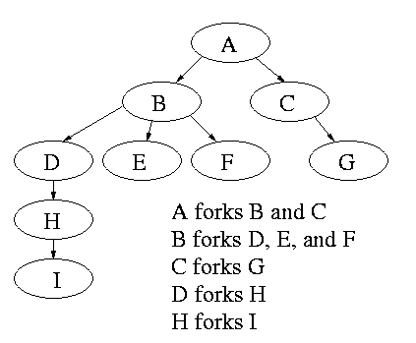
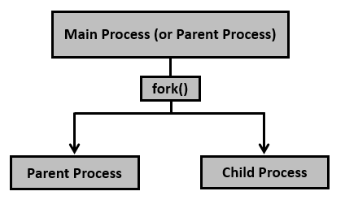
Process Creation
Fig.: A Tree of Processes in Linux

Slide 20
Creating a separate process using the UNIX fork() system call
#include <stdio.h>
#include <stdlib.h>
#include <sys/types.h>
#include <unistd.h>
int main()
{
// make two process which run same
// program after this instruction
pid_t p = fork();
if(p<0){
perror("fork fail");
exit(1);
}
printf("Hello world!, process_id(pid) = %d \n",getpid());
return 0;
}

Slide 21
Process Termination
After executing the last statement, process request for terminating by invoking exit() system call.
Terminating process should inform to its parent process about its termination via wait() system call
When a process is getting terminating, it returns its status value(generally integer) to its parent process through wait()
All the resources of the process, including physical & virtual memory, open files & I/O buffers are deallocated by the OS
Process may also be terminated by the system/ parent process for various reasons
  inability of the system to deliver necessary system resources
  parent process may kill it's children if the task assigned to them is no longer needed.
  If the parent exits, system may or may not allow the child to Continue without a parent. (on UNIX, orphaned processes are generally inherited by init, which then proceeds to kill them. )
  Some systems do not allow a child to exist if its parent has terminated. In such systems, if a process terminates, then all its children must also be terminated. This phenomenon is referred as cascaded termination, which is normally initiated by the O.S.

Slide 22
Lecture 13
Inter Process Communication
LO1: Compare different models of IPC
LO2: Summarize issues related to IPC

Slide 23
3. Inter-Process Communication(IPC)
Processes executing concurrently in the OS may be either independent or cooperating process
Independent processes are the processes which does not share any data with any other processes. These independent processes doesn’t affects other processes or does not get affected by other processes.
Cooperating processes can affect or be affected by other processes, e.g., while sharing data or resource/s.
There are several reasons for allowing processes to co-operate:
  Information sharing:- several users may be interested in the same piece of information(shared file, pipeline)
  Computation speed-up:- solution to a problem can be solved faster if the problem can be broken down into sub-problems & solved parallely(possible only when multiple processors)
  Modularity:-it is always efficient to build the system in a modular fashion by dividing system functions into separate processes or threads
  Convenience:- even single user may work on multiple tasks at the same time(such as editing, printing & computing)

Slide 24
Inter-Process Communication(IPC)
When co-operating processes are sharing some data, OS should provide some sort of communication between these co-operating processes -------IPC
So, co-operating processes requires IPC, to exchange data & information.
There are 2 fundamental models of IPC
  1) Shared Memory
  2) Message Passing

Slide 25
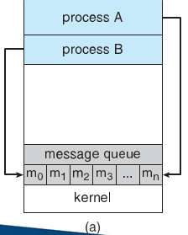
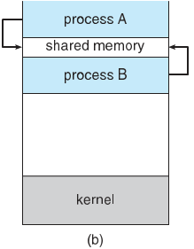
Communication Models
(a) Message passing (b) shared memory

Slide 26
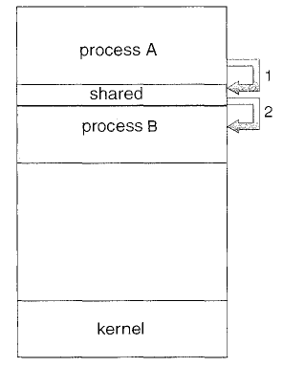
Shared Memory Systems
in this model, region of memory that is to be shared by co-operating processes is established. Processes can then exchange information by reading & writing data to the shared region
Shared memory is faster once it is established because no system calls are required & access occurs at normal memory speeds. However, it is more complicated to establish initially.
Shared memory is generally preferable when large amount of data to be shared quickly between the processes within a system.
But, it doesn't work between computers.
This shared memory region normally in the address space of a process which establishes the shared memory region.
We know that, OS prevents one process from accessing another process's memory, processes that are using this shared memory should remove this restriction.
Once the processes remove this restriction, then they can exchange data by reading & writing in the shared areas.
Processes should also ensure that they are not writing into this shared region at the same time, and not writing and reading from this shared region at the same time.

Slide 27
Message Passing Systems
In order to use shared memory concept, application programs has to write separate code for providing the facility of accessing & manipulating the shared memory.
In message passing model, communication takes place by means of messages exchanged between the cooperating processes.
message passing is simpler to establish (set-up) & works well between the computers & as well as within a computer system.
Generally, it is preferable when the amount of data transfer is small & when multiple computers are involved.
Message passing requires system calls for every message transfer & hence it is slower.
Massage passing provides a mechanism to allow processes to communicate & to synchronize their actions without sharing the same address space. This is particularly useful when communication has to be done between the systems in a network. Best example is chatting.
message passing facility provides 2 operations
  1) Send (message)
  2) Recieve (message)
  Messages sent by a process may be fixed or variable size. If only fixed size messages can be sent, system- level implementation is straightforward, but it makes task of programming more difficult.

Slide 28
Message Passing Systems
Variable sized messages requires more complex implementation (at the system level) but programming task becomes simpler
If processes P & Q want to Communicate, they must send messages to & receive messages from each other.
In order to do this, a communication channel/link has to be established.
In order to setup the communication link, there are several methods
  Direct or indirect communication
  Synchronous or Asynchronous Communication
  Automatic or explicit buffering
  Naming: Processes that wants to Communicate must have a way to refer to each other. They can use either direct or indirect Communication.
  Under direct Communication, each process should know the name of other process with which it is communicating.
  In this scheme, Send() & Receive() are defined as send (P, message)------to send a message to P
  receive(Q, message) ---receive a message from Q
  In this scheme, there should be dedicated link between sender-receiver pair.
  For symmetric Communication, both sender & receiver should know the name of each other.
  For asymmetric Communication, only sender should know the name receiver but for receiver sender’s name, need not be known.

Slide 29
Message Passing Systems
  For asymmetric Communication, only sender should know the name of receiver but for receiver no need to know sender name, Send (P, message)-------- Send a to P
  Receive(id, message)------ "id" is set to the name of process with which Communication has taken place.
  With indirect Communication, messages are sent to mailboxes or ports.
  Each mailbox has a unique identification. A mailbox can be viewed abstractly as an object into which messages can be placed by processes and from which, messages can be removed.
  In this scheme, a process can communicate with some other process via number of different mailboxes.
  send(A, message) --------send a message to mailbox A
  receive(A, message) ------receive a message from mailbox A.
  Here, multiple processes can share the same mailbox & ports. OS must provide system calls to create & delete mailboxes & to send & receive messages to / from mailboxes.
  A mailbox may be owned either by a process or by OS.
  If the mailbox is owned by a process, then we need to distinguish between the owner & the user.
  When a process that owns a mailbox terminates, mailboxes disappears

Slide 30
4. Communication in client-server systems
Sockets
Remote Procedure Calls
Pipes

Slide 31
Sockets
A socket is defined as an endpoint for communication
Concatenation of IP address and port – a number included at start of message packet to differentiate network services on a host
The socket 161.25.19.8:1625 refers to port 1625 on host 161.25.19.8
Communication consists between a pair of sockets
All ports below 1024 are well known, used for standard services
Special IP address 127.0.0.1 (loopback) to refer to system on which process is running

Slide 32
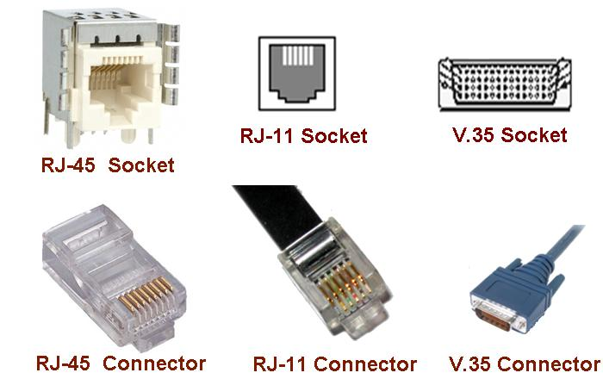
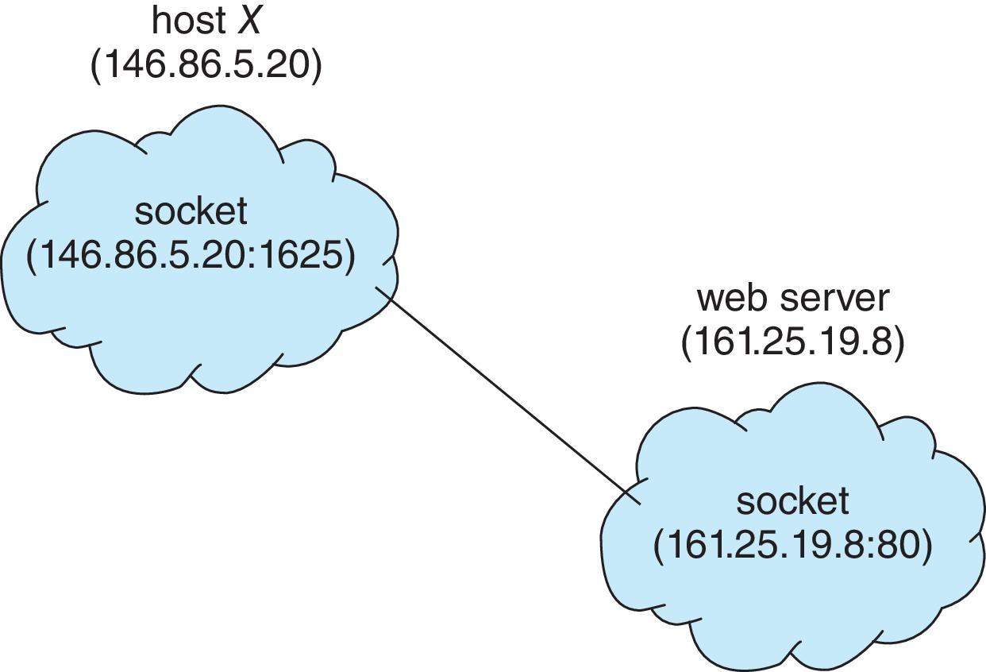
Socket Communication

Slide 33
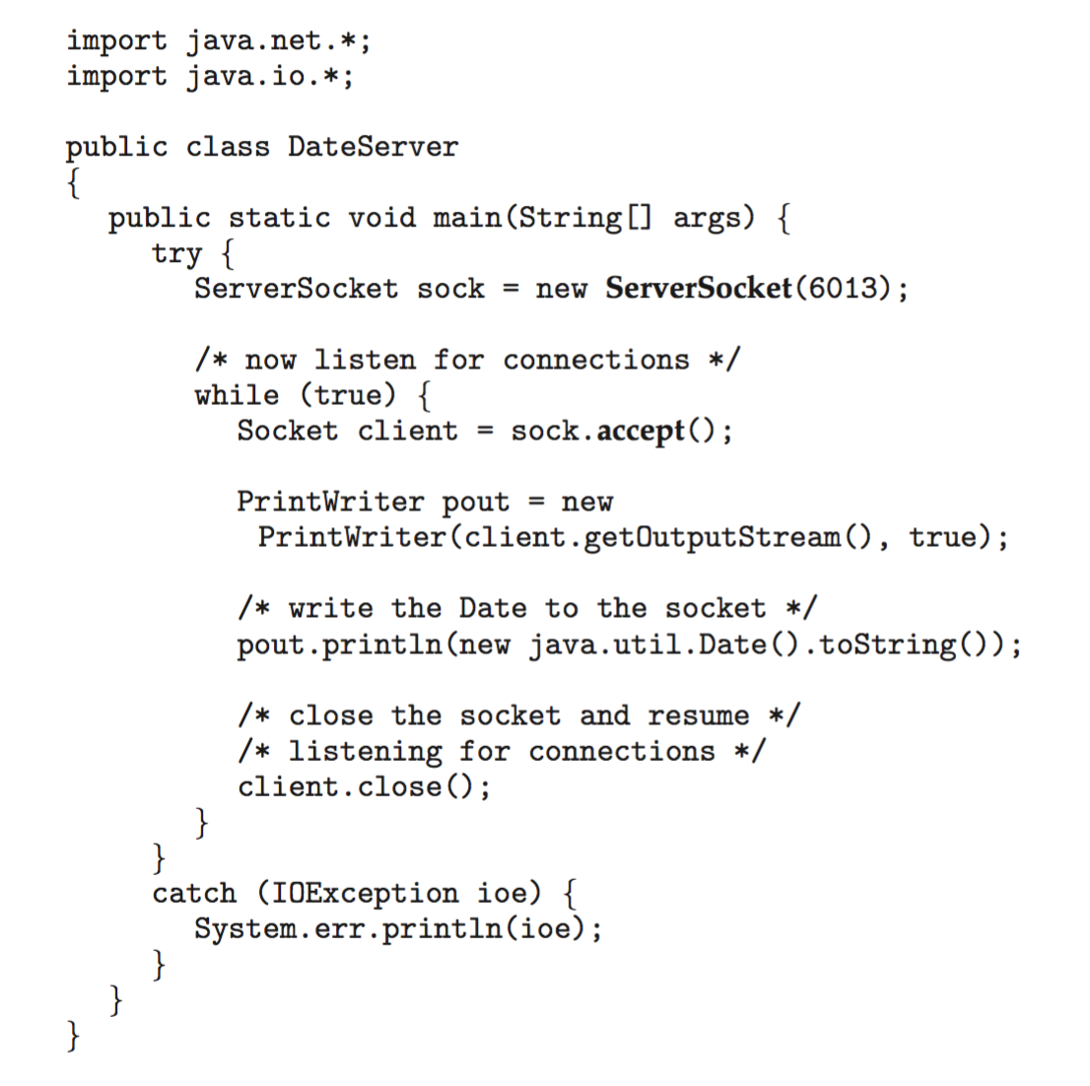
Sockets in Java
Three types of sockets
  Connection-oriented (TCP)
  Connectionless (UDP)
  MulticastSocket class– data can be sent to multiple recipients
Consider this “Date” server in Java:

Slide 34
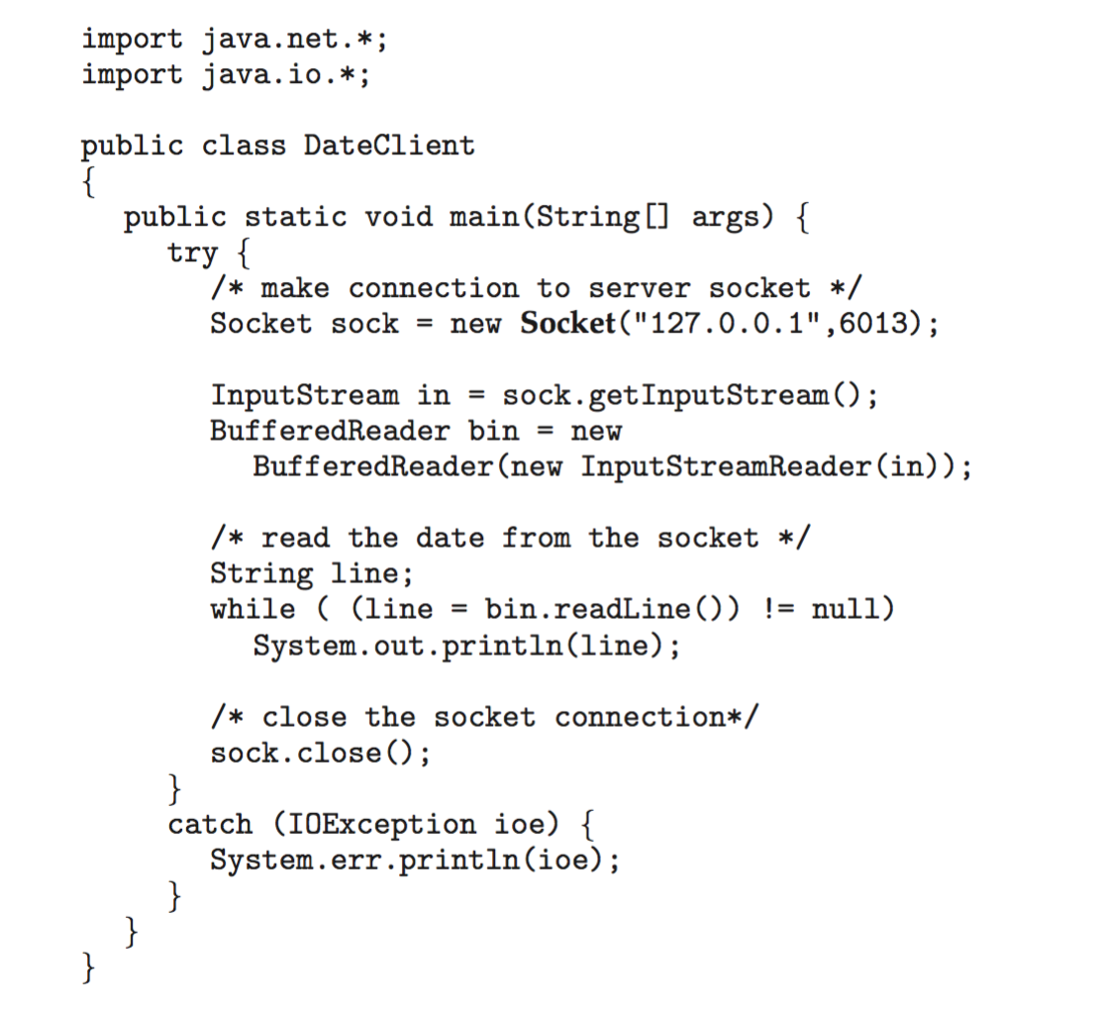
Sockets in Java
The equivalent Date client

Slide 35
Remote Procedure Calls
RPC - allows one program to execute a function or procedure on another computer in a network as if it were a local call
Stubs – client-side proxy for the actual procedure on the server
The client-side stub locates the server and marshalls the parameters
The server-side stub receives this message, unpacks the marshalled parameters, and performs the procedure on the server
On Windows, stub code compile from specification written in Microsoft Interface Definition Language (MIDL)

Slide 36
Remote Procedure Calls (Cont.)
Data representation handled via External Data Representation (XDL) format to account for different architectures
  Big-endian and little-endian
Remote communication has more failure scenarios than local
  Messages can be delivered exactly once rather than at most once
OS typically provides a rendezvous (or matchmaker) service to connect client and server

Slide 37
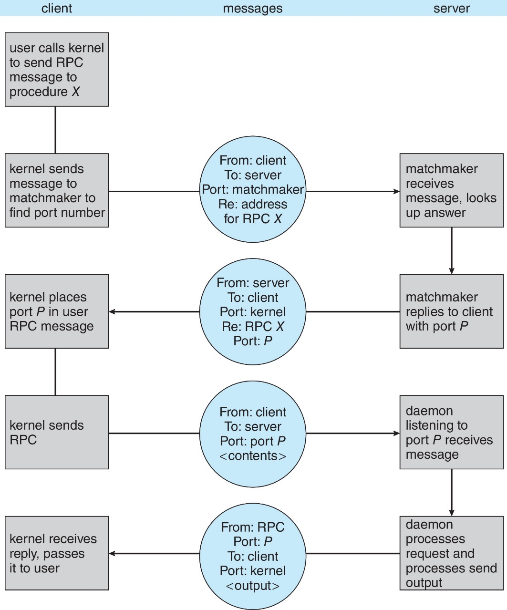
Execution of RPC

Slide 38
Pipes
Acts as a conduit allowing two processes to communicate
Issues:
  Is communication unidirectional or bidirectional?
  In the case of two-way communication, is it half or full-duplex?
  Must there exist a relationship (i.e., parent-child) between the communicating processes?
  Can the pipes be used over a network?
Ordinary pipes – cannot be accessed from outside the process that created it. Typically, a parent process creates a pipe and uses it to communicate with a child process that it created.
Named pipes – can be accessed without a parent-child relationship.

Slide 39
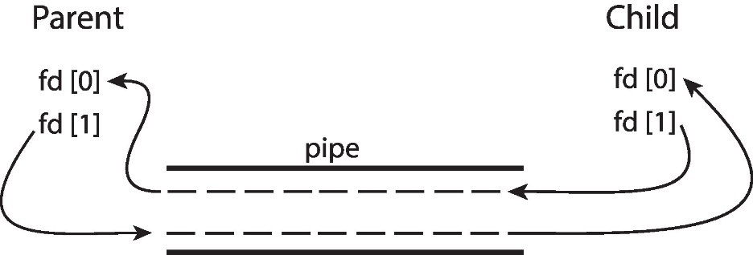
Ordinary Pipes
Ordinary Pipes allow communication in standard producer-consumer style
Producer writes to one end (the write-end of the pipe)
Consumer reads from the other end (the read-end of the pipe)
Ordinary pipes are therefore unidirectional
Require parent-child relationship between communicating processes
Windows calls these anonymous pipes

Slide 40
Named Pipes
Named Pipes are more powerful than ordinary pipes
Communication is bidirectional
No parent-child relationship is necessary between the communicating processes
Several processes can use the named pipe for communication
Provided on both UNIX and Windows systems

Slide 41
5. Threads
“A Thread is a basic unit of CPU utilization, consisting of program counter (PC), thread ID, set of registers & stack”
Traditional process (heavyweight) has a single thread of control. That means, generally each & every process should have one thread of control.
Every process has its own code segment, data segment & some OS resources like open files & signals
Single thread can perform only one specific task
Multiple threads can perform multiple tasks at a time
If a process has multiple threads, it can perform multiple tasks
A thread shares its code & data segments, OS resources with other threads belonging to the same process
41

Slide 42
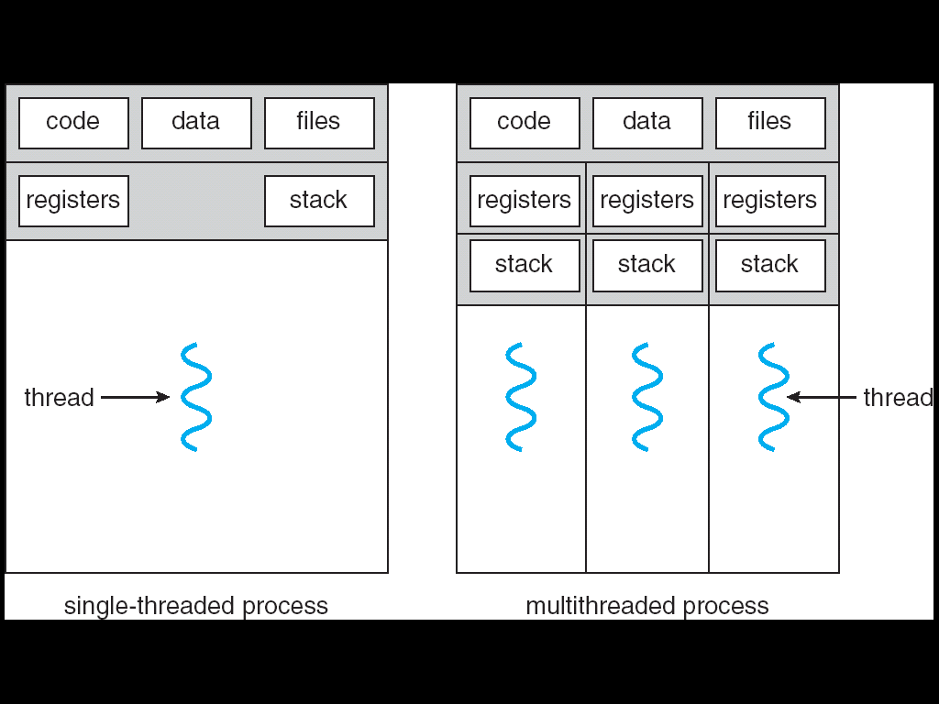
Single and Multithreaded Processes

Slide 43
Four Primary Benefits of Threading
Responsiveness
  By making an Interactive application as multithreading, we can allow it to continue running even if part of it is blocked or performing lengthy computations, thereby increasing responsiveness to the user
  For example, multithreaded web browser could allow user interaction in one thread while an image/document was being uploaded/downloaded in another thread
Resource Sharing
  Processes may only share resources through shared memory or message passing techniques.
  However, Threads share memory & the resources of the process to which they belongs by default.
  Benefit of sharing code & data is that, it allows an application to have several different threads within same address space
Economy/Efficiency
  Resource allocation is costly.
  Sharing reduces overhead and reduces the cost of context switching during CPU scheduling
43

Slide 44
Four Primary Benefits of Threading
Scalability
  Benefits of multithreading can be greatly increased in a multiprocessor architecture, where threads may be running in parallel on different processors
  A single-threaded process can only run on one processor, regardless how many are available
  Multithreading on a multi-CPU machines increases parallelism.
44

Slide 45
6. Multithreading Models
2 types of threads to be managed in a modern system
  User threads
  Kernel threads
  User threads are supported above the kernel & are managed without kernel support
Kernel threads are supported & managed directly by OS. Kernel threads are supported within the kernel of the OS itself
A relationship exists between user and kernel threads
There are 3 common ways to establish relationship between user & kernel thread
  Many-to-One
  One-to-One
  Many-to-Many
45

Slide 46
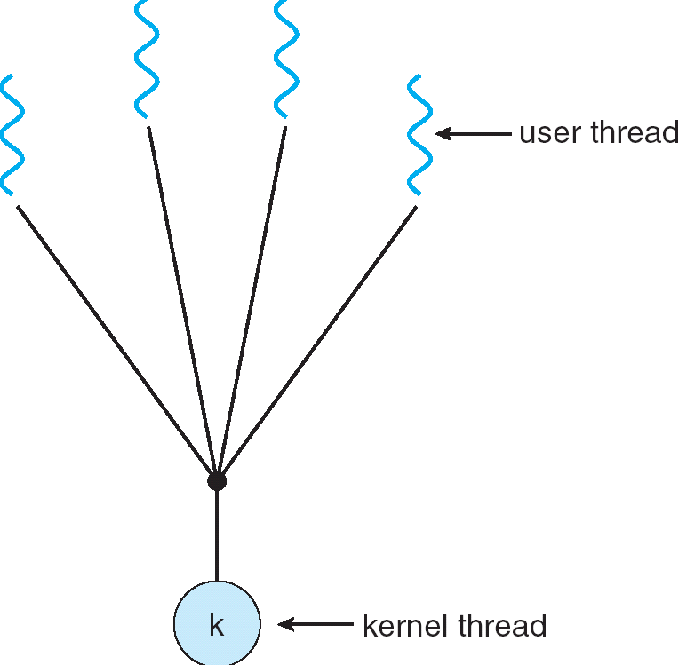
Many-to-One Model
Many user-level threads mapped to single
kernel thread
12

Slide 47
Many-to-One
Many user-level threads mapped to single kernel thread
Thread management is handled by the thread library in user space, which is very efficient.
If any user thread makes a blocking system call, then entire process will be blocked. Due to this, other threads also cannot continue.
Since, only one thread can access the kernel at a time, multiple threads are unable to run in parallel on multiprocessors
Example:
  Solaris Green Threads
13
Notes:
Green Threads – special threads that are managed by thread libraries or by virtual machine, instead of OS.

Slide 48
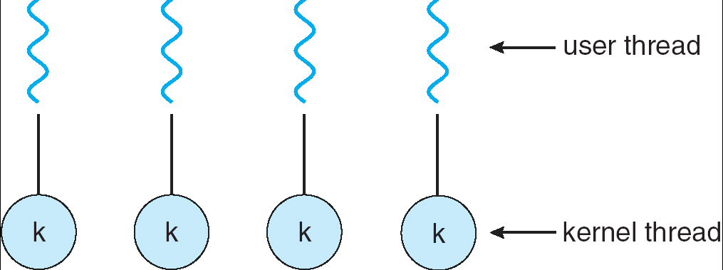
One-to-one Model
Each user-level thread maps to a unique kernel thread
14

Slide 49
One-to-One
Each user-level thread maps to a unique kernel thread
Examples
  Windows NT/XP/2000
  Linux
  Solaris 9 and later
It provides concurrency(parallelism) more than the many-to-one by allowing another thread to run when a thread makes a blocking system call
  Allows multiple threads to run in parallel on multi-processors
Cons
  Creating user thread requires creating a unique kernel thread
  Overhead of kernel-thread creation can burden performance & hence system becomes slower
  Number of user threads and number of kernel threads must be bounded.
15

Slide 50
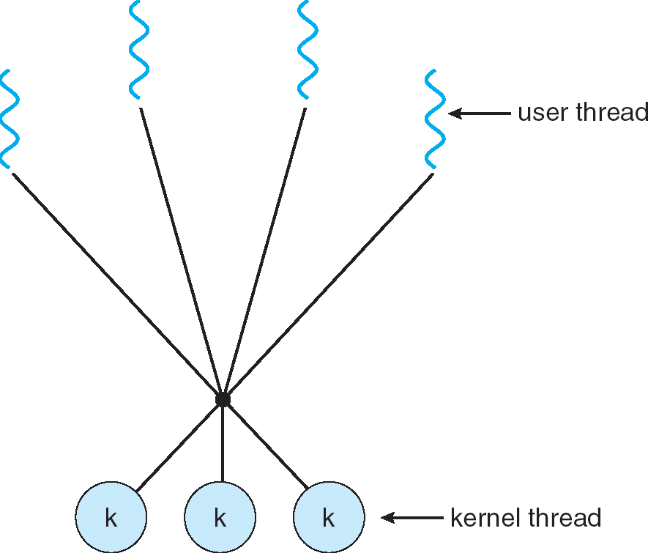
Many-to-Many Model
Many user-level threads mapped to single kernel thread
16

Slide 51
Many-to-Many Model
Many user level threads are mapped to an equal or smaller number of kernel threads
Combines the best features of one-to-one and many-to-one models
Allows OS to create a sufficient number of kernel threads
  Solaris prior to version 9
  Windows NT/2000 with the ThreadFiber package
Advantages:
  Developers can create as many user threads as necessary(no restriction)
  Corresponding kernel threads can execute in parallel
  Blocking kernel system calls do not block the entire process

Slide 52
6. Thread Libraries
Thread library provides programmer with API for creating and managing threads
Two primary ways of implementing
  Library entirely in user space
  Kernel-level library supported by the OS

Slide 53
Pthreads
POSIX stands for Portable Operating System Interface
May be provided either as user-level or kernel-level
A POSIX standard (IEEE 1003.1c) API for thread creation and synchronization Specification, not implementation
API specifies behavior of the thread library, implementation is up to development of the library
Common in UNIX operating systems (Linux & Mac OS X)

Slide 54
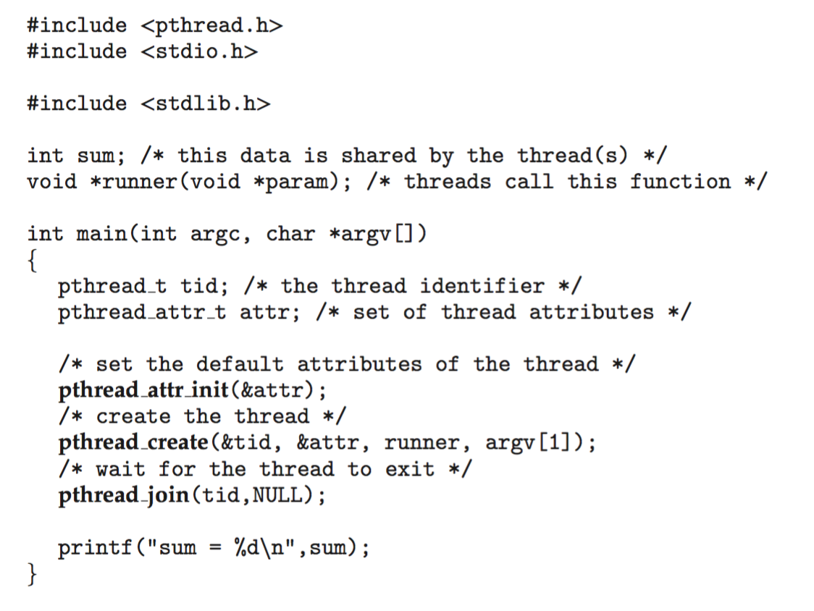
Pthreads Example

Slide 55
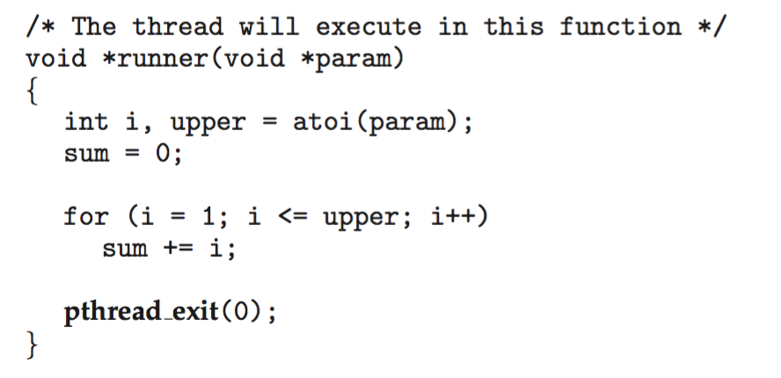
Pthreads Example (Cont.)

Slide 56
Pthreads Code for Joining 10 Threads

Slide 57
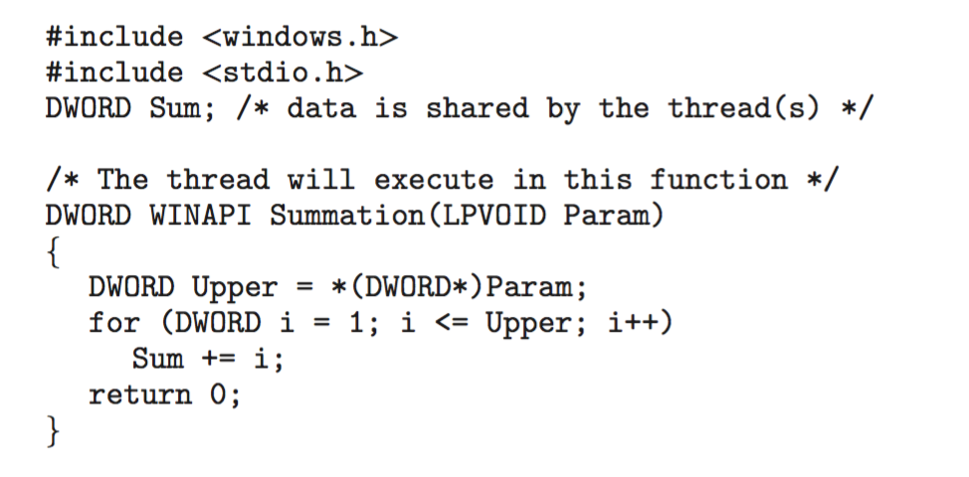
Windows Multithreaded C Program

Slide 58
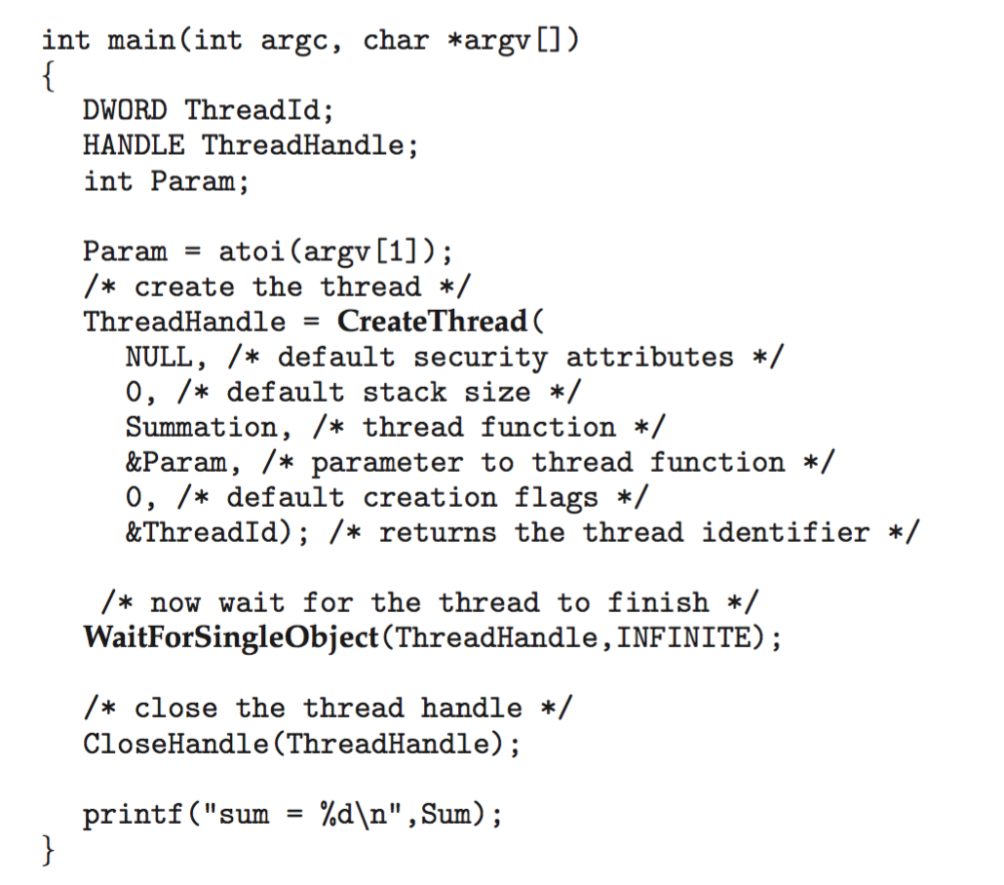
Windows Multithreaded C Program (Cont.)

Slide 59
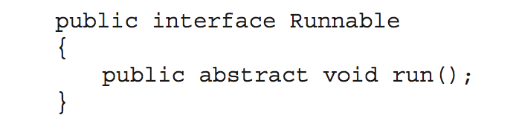
Java Threads
Java threads are managed by the JVM
Typically implemented using the threads model provided by underlying OS
Java threads may be created by:
  Extending Thread class
  Implementing the Runnable interface
  Standard practice is to implement Runnable interface

Slide 60
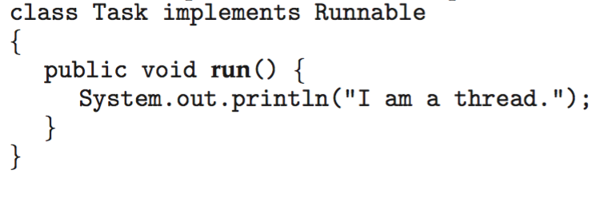
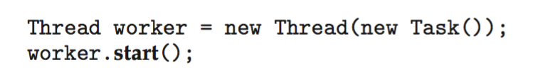
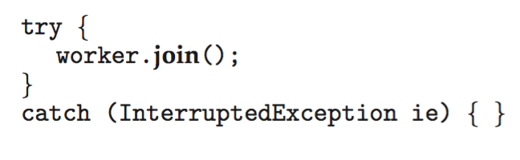
Java Threads
Implementing Runnable interface:
Creating a thread:
Waiting on a thread:

Slide 61
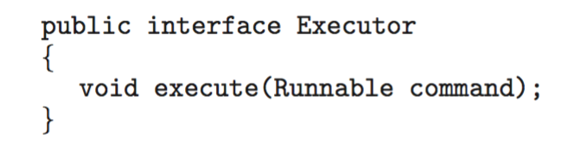
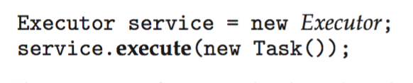
Java Executor Framework
Rather than explicitly creating threads, Java also allows thread creation around the Executor interface:
The Executor is used as follows:

Slide 62
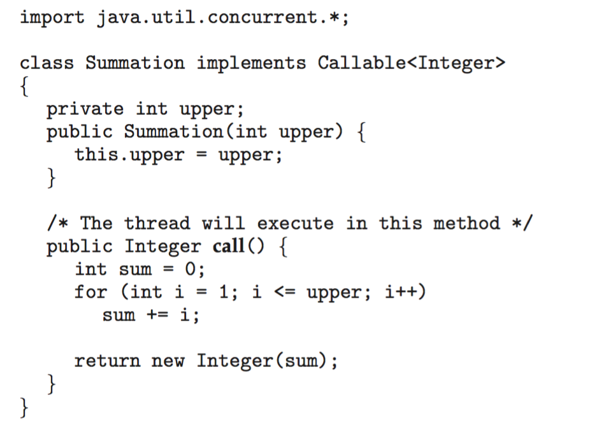
Java Executor Framework

Slide 63
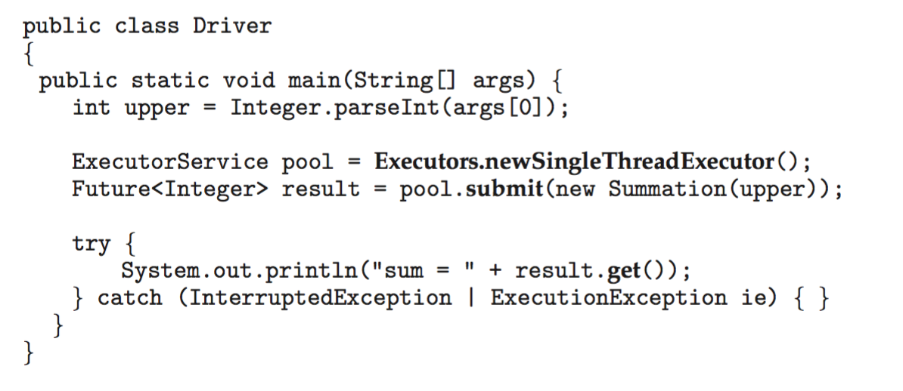
Java Executor Framework (Cont.)

Slide 64
8. Threading Issues- 1) fork() & exec()
Issues to be considered while using multithreaded programs
1) fork() and exec() system calls
  Fork() is used to create a separate, duplicate process
  Now the question is, if one thread in a program calls fork(), whether the entire process is copied or new process is created only for that single thread?
  Actually it is system dependent.
  In some systems(Unix), it duplicates all threads(creates entirely new process) & as well as duplicates only the thread that invokes fork()

Slide 65
Threading Issues
exec() system calls
  exec() is used to run an executable file in the context of an already existing process, replacing the previous executable
  If a thread invokes exec(), the program specified in the parameter to exec() will replace the entire process, including all threads
  Challenging is to decide, which of the 2 versions of fork() is to be used.
  If exec() is called immediately after forking, then duplicating all threads is unnecessary, as the program specified in the parameters to exec() will replace the process

Slide 66
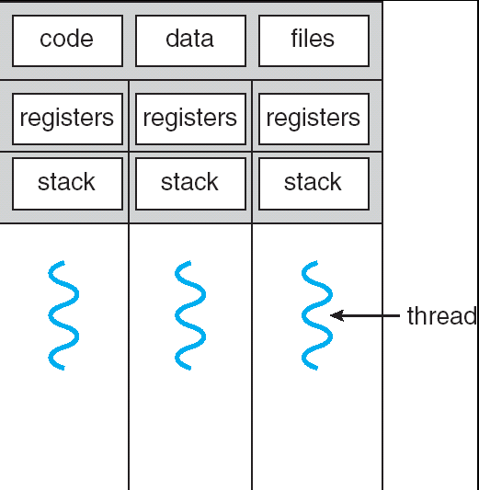
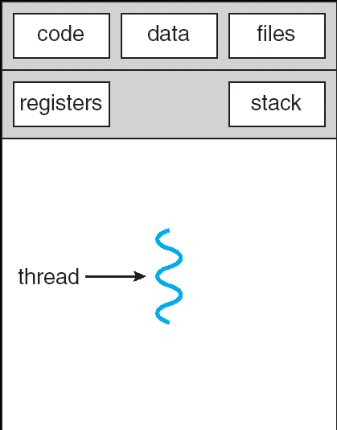
Semantics of fork() and exec()
Does fork() duplicate only the calling thread or all threads?
Some UNIX systems have two versions of fork()
exec() usually replaces all threads with new program
fork1()
fork2()

Slide 67
Threading Issues- 2)Thread Cancellation
Thread cancellation is the task of terminating a thread before it completes its action.
A thread that is to be cancelled is referred as target thread.
Threads that are no longer needed may be cancelled by another thread in one of 2 way's
  Asynchronous Cancellation
  Deferred Cancellation
  In asynchronous cancellation, one thread immediately terminates the target thread.
  Threads which are sharing the resources & as well as threads involved in inter-thread data transfer with the target thread gets affected.
  To overcome these disadvantages, deferred cancellation is preferred.
  In deferred cancellation, target thread itself sets a flag indicating the thread should cancel itself when it is convenient. It is then up to the cancelled thread to check this flag periodically & exit nicely when it sees the flag set.

Slide 68
Threading Issues- 3) Signal Handling
Signals are used to inform processes indicating some events are occurred
Signals are used only in the unix
A signal may be received either synchronously or asynchronously
Now the question is, when a multithreaded process receives a signal, to which thread should this signal be delivered?
For this, there are 4 options:
1) Deliver the signal to the thread to which that signal applies
  2) Deliver the signal to every thread in the process
3) Deliver the signal to certain threads in the process
4) Assign a specific thread to receive all signals to the process
The best choice may depend on which specific signal is involved.
UNIX allows individual threads to indicate which signals they are accepting & which they are ignoring
However, signals can be delivered to only one thread, which is generally the first thread that is accepting that particular signal
UNIX provides 2 separate system calls kill(pid,signal) & pthread_kill(tid,signal)

Slide 69
Threading Issues- 4) Thread Pools
Creating new threads everytime when it is needed & deleting after it is done, can be inefficient & can also lead to a (unlimited) number of threads being created.
An alternative solution is to create a number of threads when the process first starts & put those threads into a Thread pool.
Threads are allocated from the pool as needed & then returned back to the pool when no Longer needed.
When no threads are available in the pool, the process may have to wait until one becomes fre/available
Win32 provides thread pool through “PoolFunction()” function
Java provides through java.util.concurrent package

Slide 70
Threading Issues- 5) Thread-specific Data
A process may Contain one thread (single threaded) or multiple threads (multi threaded).
Threads belonging to process shares the data of that process .Actually, this sharing of data is one benefit of multithreaded programming.
But in some situations, each thread might need it's own copy of Certain data. Such data is called thread specific data.
If data is sharing, that cannot be modified by any thread.
Sometimes, a thread needs some data & later it has to perform some Calculation/processing on that. For this reason, thread needs its own copy of specific data.

Slide 71
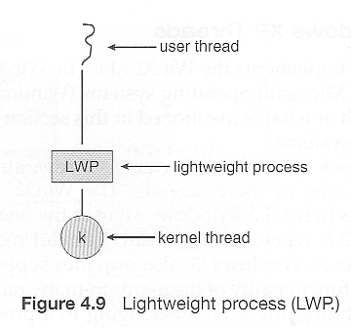
Threading Issues- 6) Scheduler activations
Final issue to be considered in an multithreaded programming is the communication between the kernel & the thread library
Actually, some interface is required between the user thread & the kernel thread, particularly for many-to-many model
This interface is an data structure typically known as Light Weighted Process (LWP).
Generally, this interface is an virtual processor called Lightweight process
There is one-to-one correspondence between LWP’s & kernel threads

Slide 72
9. Basic Concepts of CPU Scheduling

Slide 73

Basic Concepts
CPU scheduling (Process Scheduling) is the basis of multiprogrammed OSs
  By switching the CPU among processes the OS can make the computer more productive
  In a single-processor system, only one process can run at a time; all the other processes in the queue has to wait until the CPU is free.
  The objective of multiprogramming is to have some process running at all times, to maximize CPU utilization.
  Assume, one process is running & some other processes are waiting for CPU. CPU becomes free after completing the task of already running process.
  Sometimes, running process may need some I/O resources to complete the task & they request for I/O. But, at that time, I/O is busy. So, the running process go to wait state & now CPU is idle.
  Instead of making CPU idle, we can allocate CPU to one of the waiting processes which are waiting for CPU.
  So, every time one process has to wait, another process can take over the use of CPU.
  Allocating CPU from one process to another is done by scheduler & the procedure is called process scheduling.

Slide 74
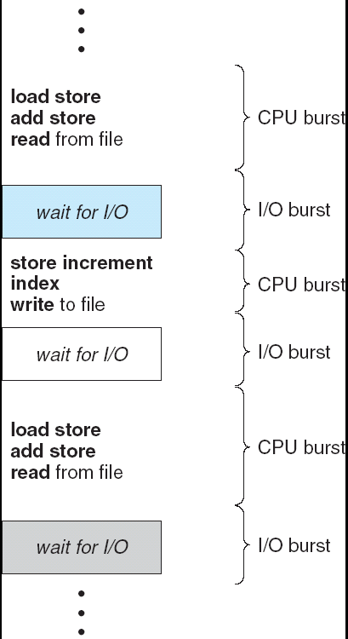
CPU/IO Burst Cycle
Almost every process needs CPU for some time to complete their calculations and /or computations.
Meanwhile, every process needs I/O services in order to make some data transfer.
When process is using CPU time, then it is referred as CPU-burst
When process is using I/O, then it is referred as I/O-burst
Processes alternate between these 2 states.
Always, process begins & ends with CPU burst

Slide 75
CPU Scheduler
Whenever the CPU becomes idle, it is the job of CPU scheduler to select the next process to be executed, which are in the ready queue
CPU scheduler (or short term scheduler) selects from among the processes in memory that are ready to execute, and allocates the CPU to one of them
Conceptually all the processes in the ready queue are lined up waiting for a chance to run on the CPU
  Records in the queue are generally the PCB of the processes
  Pre-emptive scheduling
  CPU scheduler selects the next process in 4 situations
  1) when a process switches from the running state to the waiting rate (such as, for an I/O request or invocation of wait() system call) -NPE
  2) when a process switches from running state to the ready state (for ex, in response to an interrupt).
  3) When a process switches from waiting state to ready state (say, at Completion of I/0 or a return from wait()
  4) when a process terminates - NPE

Slide 76
CPU Scheduler
  For situations 1 & 4, there is no choice, CPU scheduler has to select new process
  For situations 2 & 3, there is a choice - either continue running the current process or select a new process
  If scheduling takes place only under situations 1 & 4, then the scheduling is called non-preemptive scheduling or also called as co-operative
  In non-preemptive scheduling, once a process starts running, it keeps running until it either voluntarily blocks or until it finishes.
  If scheduling takes place only under situations 2 & 3, then scheduling is called preemptive scheduling.
  Preemptive scheduling is only possible on the hardware that supports a timer interrupt.
  In preemptive scheduling, Currently running process is (stopped or) put it into the waiting state & new process is selected if that new process is having highest priority than the currently running.
  upto windows 3.x, non-preemptive is used & from windows 95 preemptive is using.
  But, there are some few problems / disadvantages associated with preemptive, they are
    *) when 2 process are sharing the data & one process is updating that data & assume it get preempted before updating. Then when another process access this shared data, it will get inconsistent data.
    *) preemption affects the design of OS Kernel. When OS Kernel is executing (say implementing / servicing system call) on behalf of process & that process is preempted, then it affects OS kernel.

Slide 77
Dispatcher
Dispatcher is the module that allocates CPU to the process selected by the short-term scheduler. This involves:
  switching context
  switching to user mode
  jumping to the proper location in the user program to restart that program
  The dispatcher needs to be as fast as possible, as it is run on every context switch.
  The time consumed by the dispatcher to do the above said functions is known as dispatch latency.
Dispatch latency – time it takes for the dispatcher to stop one process and start another running

Slide 78
10. Scheduling Criteria
There are many different scheduling algorithms. Deciding which is the best scheduling algorithm in particular situation is difficult.
There are several different criteria to consider, when trying to select the best scheduling algorithm for a particular situation & environment.
Those criteria's are
* CPU utilization : Always CPU should be kept busy always as possible.
* Throughput :In order to measure, amount of work done by CPU, throughput is used. Number of processes that are Completed per unit of time is called as throughput.

Slide 79
Scheduling Criteria (2)
*) Turnaround time – amount of time to execute a particular process. Interval from the time of submission of a process to the time of completion
turnaround time is the sum of the periods spent waiting to get into main memory, waiting in the ready queue, executing on the CPU & doing I/O.
*) Waiting time – amount of time a process has been waiting in the ready queue
*) Response time – In an interactive system, turnaround time may not be the best criterion. Often, a process can produce some output fairly early & can continue computing new results while previous results are being output to the user.
thus, another measure is the time from the submission of a request until the first response is produced. This measure, Called response time, is the time it takes to start responding, not the time it takes to output the response.
Waiting Time = CPU Allocation Time – Arrival Time

Slide 80
Optimization Criteria
Maximize CPU utilization
Maximize Throughput
Minimize Turnaround time
Minimize Waiting time
Minimize Response time

Slide 81
11. Scheduling Algorithms
CPU should select one process out of many processes which are in ready queue after completing the current process
In order to select, there are so many scheduling algorithms
First Come First Serve (FCFS)
Shortest Job First (SJF)
Priority scheduling
Round Robin scheduling

Slide 82
First-Come, First-Served Scheduling (FCFS)
Simplest CPU scheduling algorithm
Process that requested the CPU first is allocated the CPU first
Implementation managed by a First In First Out (FIFO) queue
  When a process enters the ready queue its PCB is linked onto the tail of the queue
  When the CPU is free, it is allocated to the process at the head of the queue and the running process is removed from the queue
Disadvantage:
  If the currently running process (or the first process in the ready queue) takes much time then all other processes has to wait for long time
  Average waiting time under FCFS policy is often quite long
Nonpreemptive algorithm → once the CPU has been allocated to a process, the process keeps the CPU until it releases the CPU

Slide 83
First-Come, First-Served Scheduling(FCFS)
Process | CPU Burst Time (ms)
P₁ | 24
P₂ | 3
P₃ | 3
Suppose that the processes arrive (at time 0) in the order: P₁ , P₂ , P₃
The Gantt Chart for the schedule is:
P₁ | P₂ | P₃
0
24
27
30
Waiting time for P₁ = 0; P₂ = 24; P₃ = 27
Average waiting time: (0 + 24 + 27)/3 = 17 m sec

Slide 84
FCFS Scheduling (Cont.)
Suppose if same 3 processes arrives in the order P₂ , P₃ , P₁
The Gantt chart for the schedule is:
P₂ | P₃ | P₁
Waiting time for P1 = 6; P2 = 0; P3 = 3
Average waiting time: (6 + 0 + 3)/3 = 3m sec
Much better than previous case
30
0
3
6
Thus, average waiting time of FCFS keeps on changing according to their arrival & their burst time
While processes wait in the ready queue, I/O devices are idle. At the same time, CPU-bound process finishes its CPU burst & moves to an I/O device.
All the I/O bound processes, which have short CPU bursts, execute quickly & move back to the I/O queues. At this point, CPU sits idle.
CPU-bound process will then move back to the ready queue & be allocated the CPU.
Again, all I/O processes end up waiting in the ready queue until the CPU bound process is done.
There is a Convey Effect as all the other processes wait for the one big process to get off The CPU.

Slide 85
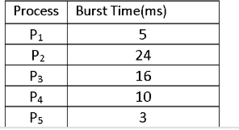
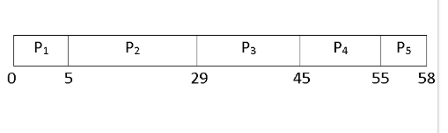
FCFS contd.
calculate the average waiting time, average turnaround time and throughput.
Average Waiting Time
Waiting Time = Starting Time - Arrival Time
Waiting time of P1 = 0 P2 = 5 - 0 = 5 ms
P3 = 29 - 0 = 29 ms
P4 = 45 - 0 = 45 ms
P5 = 55 - 0 = 55 ms
Average Waiting Time = Waiting Time of all Processes / Total Number of Process
Therefore, average waiting time = (0 + 5 + 29 + 45 + 55) / 5 = 25 ms
Average Turnaround Time
Turnaround Time = Waiting time in the ready queue + executing time + waiting time in waiting-queue for I/O

Slide 86
Turnaround time of P1 = 0 + 5 + 0 = 5ms
P2 = 5 + 24 + 0 = 29ms
P3 = 29 + 16 + 0 = 45ms
P4 = 45 + 10 + 0 = 55ms
P5 = 55 + 3 + 0 = 58ms
Total Turnaround Time = (5 + 29 + 45 + 55 + 58)ms = 192ms
Average Turnaround Time = (Total Turnaround Time / Total Number of
Process) = (192 / 5)ms = 38.4ms
Throughput
Here, we have a total of five processes. Process P1, P2, P3, P4, and P5 takes 5ms, 24ms, 16ms, 10ms, and 3ms to execute respectively. Throughput = (5 + 24 +16 + 10 +3) / 5 = 11.6ms
It means one process executes in every 11.6 ms.

Slide 87
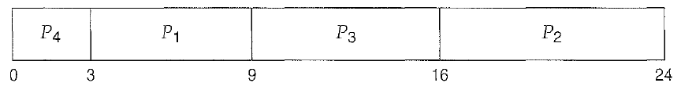
Scheduling Algorithms: SJF and SRTF
Process | Burst Time
P1 | 6
P2 | 8
P3 | 7
P4 | 3
CPU is assigned to the process that has the smallest next CPU burst
If the 2 processes are having same CPU burst, tie can be broken using FCFS
This SJF is also called as Shortest next CPU burst algorithm
Consider the following set of processes with the length of the CPU burst given in millisec
Waiting time of P4=0msec
Waiting time of P1=3msec
Waiting time of P3=9msec
Waiting time of P2=16msec
Average waiting time =(0+3+9+16)/4=7 msec

Slide 88
Shortest-Job-First (SJF)
SJF is an optimal scheduling algorithm when compared to FCFS.
Moving a short process before a long one decreases the waiting time of the short process more than it increases the waiting time of the long process.
The real difficulty with the SJF algorithm is knowing length of the next CPU request.
SJF algorithm can be either preemptive & non-preemptive.
The choice arises when a new process arrives at the ready queue while a previous process is still executing.
The next CPU burst of the newly arrived process may be shorter than what is left of the currently executing process.
A preemptive SJF algorithm will preempt the currently executing process, whereas a non-preemptive SJF algorithm will allow the currently running process to finish its CPU burst.
Preemptive SJF scheduling is also called shortest- remaining-time-first.

Slide 89
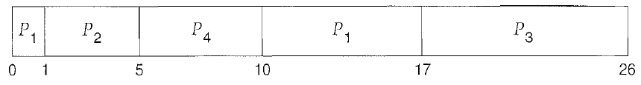
SJF
Consider the following 4 processes, with the length of CPU burst given in milliseconds.
If the 4 Processes arrives in the order shown in the table
Process | Arrival Time | Burst Time
P1 | 0 | 8
P2 | 1 | 4
P3 | 2 | 9
P4 | 3 | 5
Waiting time for P1=0 + (10-1)= 9 msec
Waiting time for P2=0
Waiting time for P3=17 – 2 = 15 msec
Waiting time for P4=5 – 3 = 2 msec
Average waiting time =(9+0+15+2)/4= 6.5 msec

Slide 90
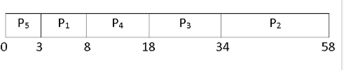
SJF (Shortest Job First) Scheduling
Assuming arrival time is 0 for all the processes
Waiting time for P1 = 3 – 0 = 3 msec
Waiting time for P2= 34 – 0 = 34 msec
Waiting time for P3= 18 – 0 = 18 msec
Waiting time for P4= 8 – 0 = 8 msec
Waiting time for P5= 0 msec
Average Waiting Time = (3 + 34 + 18 + 8 + 0) / 5 = 12.6ms
Turnaround Time of
P1 = 3 + 5 = 8ms
P2 = 34 + 24 = 58ms
P3 = 18 + 16 = 34ms
P4 = 8 + 10 = 18ms
P5 = 0 + 3 = 3ms
Here, we have a total of five processes. Process P1, P2, P3, P4, and P5 takes 5ms, 24ms, 16ms, 10ms, and 3ms to execute respectively
Therefore, Throughput will be same as above problem i.e., 11.6ms for each process
Average Turnaround Time = (8 + 58 + 34 + 18 + 3) / 5 = 24.2ms

Slide 91
Example of Non-Preemptive SJF
Processes Arrival Time Burst Time (ms)
P₁ P₂ P₃ P₄
0.0
2.0
4.0
5.0
7
4
1
4
P₁ |  |  |  |  |  |  | P₃ | P₂ |  |  |  | P₄
0 3 7 8 12
Average waiting time = (0 + 6 + 3 + 7)/4= 4msec
SJF (non-preemptive)

Slide 92
Example of Preemptive SJF
Process | Arrival Time | Burst Time
P₁ | 0.0 | 7
P₂ | 2.0 | 4
P₃ | 4.0 | 1
P₄ | 5.0 | 4
P₁ |  | P₂ |  | P₃ | P₂ |  | P₄ |  |  |  | P₁
SJF (preemptive)
0
2 4 5 7
11
16
Average waiting time = (9 + 1 + 0 +2)/4 = 3

Slide 93
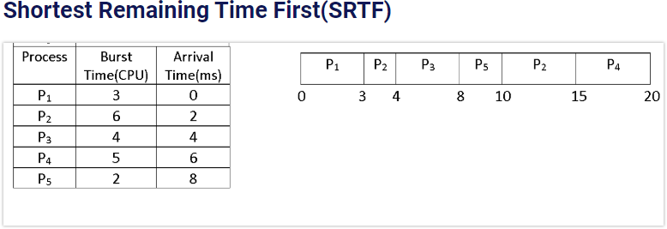
SRTF

Slide 94
Scheduling Algorithms: Priority Scheduling
A priority number (integer) is associated with each process
The CPU is allocated to the process with the highest priority (in this text, smallest integer ≡ highest priority)
  Equal priority processes are scheduled using FCFS
  Priority scheduling can be:
    preemptive: preempt CPU if priority of newly arrived process is higher than priority of currently running process
    nonpreemptive: put the new highest priority process at the head of the ready queue
SJF is a priority scheduling where priority is the inverse of the predicted next CPU burst time (largest CPU burst → lowest priority)
External priorities are assigned by users, based on the importance of the job, fees paid, politics, etc

Slide 95
Priority Scheduling
Problem ≡ Starvation – low priority processes is indefinitely blocked and may never execute
  In a heavily loaded system a steady stream of higher priority processes can prevent a lower priority process from ever getting the CPU
Solution ≡ Aging – as time progresses gradually increase the priority of processes that have been waiting for a long time

Slide 96
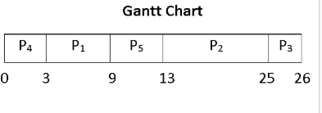
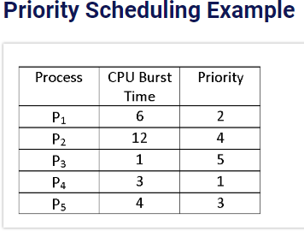
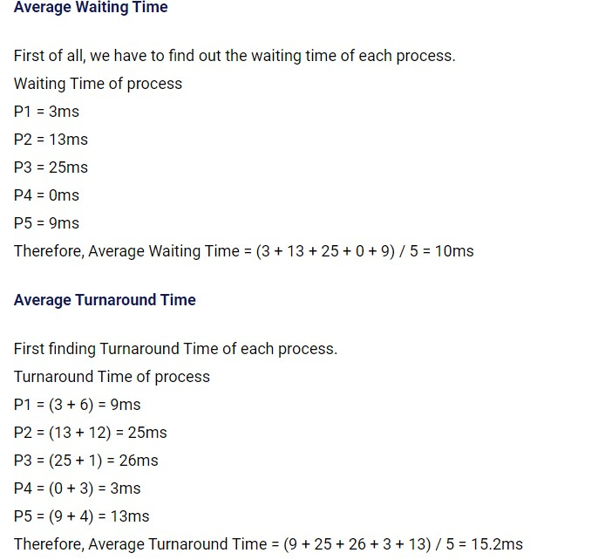
Priority Scheduling

Slide 97
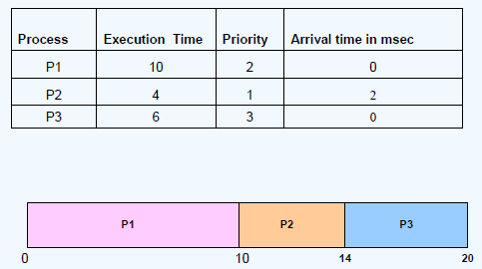
Priority Scheduling (Non Preemptive method)

Slide 98
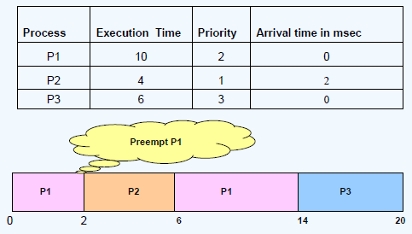
Priority Scheduling (Preemptive method)

Slide 99
Scheduling Algorithms: Round Robin (RR)
This round robin scheduling algorithm is designed especially for time-sharing systems.
RR is similar to FCFS scheduling, except that CPU bursts are assigned with a small unit of time called time quantum or time slice
Each process gets a small unit of CPU time (time quantum), usually 10- 100 milliseconds. After this time has elapsed, the process is preempted and added to the end of the ready queue.
If there are n processes in the ready queue and the time quantum is q, then each process gets 1/n of the CPU time in chunks of at most q time units at once. No process waits more than (n-1) x q time units until its next quantum.
Performance depends on size of q
  q large ⇒ FIFO
  q small ⇒ RR approach is called processor sharing and creates appearance that each of the n processes has its own processor running at speed 1/n
  q must be large with respect to context switch, otherwise overhead is too high

Slide 100
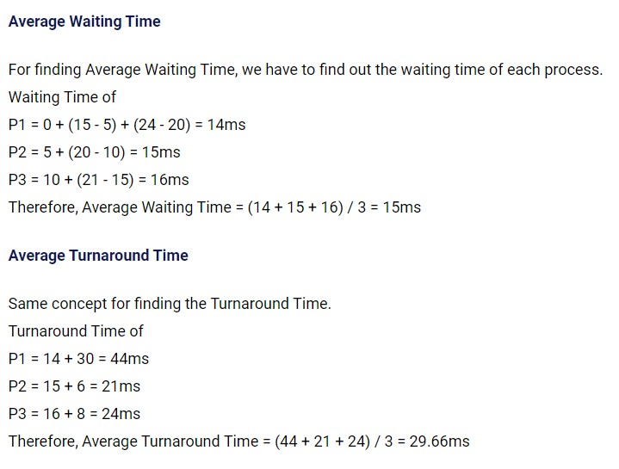
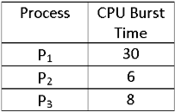
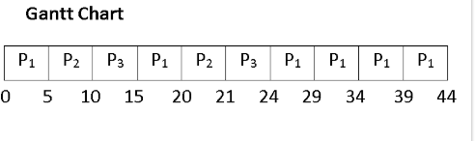
Round Robin
time quantum 5ms

Slide 101
Round Robin Scheduling
Each process is given CPU time in turn, (i.e. time quantum:usually 10-100 milliseconds), & thus waits no longer than ( n – 1 ) * time quantum
time quantum = 20
Process | Burst Time
P₁ | 53
P₂ | 17
P₃ | 68
P₄ | 24
Wait Time
57 +24 = 81
20
37 + 40 + 17= 94
57 + 40 = 97
P₁ | P₂ | P₃ | P₄ | P₁ | P₃ | P₄ | P₁ | P₃ | P₃
0 20 37 57 77 97 117 121 134 154 162
71

Slide 102

Round Robin Scheduling
Typically, higher average turnaround than SJF, but better response.
Performance
  q large ⇒ FCFS
  q small ⇒ q must be large with respect to context switch, otherwise
overhead is too high.

Slide 103
Example of RR with Time Quantum = 20
Process | Burst Time
P₁ | 53
P₂ | 17
P₃ | 68
P₄ | 24
The Gantt chart is:
0 20 37 57 77 97 117 121 134 154 162
Typically, higher average turnaround than SJF, but better response
P₁ | P₂ | P₃ | P₄ | P₁ | P₃ | P₄ | P₁ | P₃ | P₃

Slide 104

Turnaround Time Varies With The Time Quantum
Average turnaround time does not necessarily improve as size of q increases
Generally, average turnaround time can be improved if most processes finish
their CPU burst in a single time quantum
74

Slide 105
Solve the following problem using
1. FCFS,
2. SJF,
3. Preemptive Priority,
4. Round-Robin (quantum = 2).
For each algorithm draw the Gantt chart & Find Completion / Turnaround / Waiting times per process, and the average TAT / average WT
Process | Arrival time | Burst time | Priority (1 = highest)
P1 | 0 | 10 | 3
P2 | 1 | 1 | 1
P3 | 2 | 2 | 4
P4 | 3 | 1 | 5
P5 | 4 | 5 | 2

Slide 106
Thank You
84

